Slide 1
WEB COMPUTATIONAL BIOLOGY TRAINING
1
Notes:
1

Slide 2

Today’s Instructor
Bioinformatics and Computational Biosciences Branch (BCBB), Rocky Mountain Laboratories (RML), NIAID,
NIH, Hamilton, MT USA.
Contact our team via email:
Email: ace@icermali.org
Listserv: ACE-MALI-L@LIST.NIH.GOV
Instructor: amitava.roy@nih.gov
Dr. Amitava Roy,
Ph.D. in Physics
Ongoing Computational Biology projects:
Vaccine development
Structure determination of prion
2

Slide 3
Alignment methods
Introduction to global and local sequence alignment methods
Global : Needleman-Wunsch
Local : Smith-Waterman
BLAST
Scoring Matrices
PAM
BLOSUM

Slide 4
Function Prediction
Multiple Sequence Alignment
Dynamics Programming
ClustlW, t-Coffee, Muscle
Motif Search and Function Prediction
Expectation Maximization, MEME
Markov Model and Hidden Markov Model
Software

Slide 5
Statistical significance of database hits
“P-value” - the estimated probability that the match observed could have occurred by chance
or
E-value - the number of results with this score expected by chance (assuming a specific distribution of residues).
An E-value of 5 would mean that you would expect 5 alignments with the equivalent or higher score to have occurred by random chance
More reliable than the % ID
Statistical estimates like these are strongly influenced by the size and composition of both the search sequence and the database.
Caution:
Repeat regions
Transitive annotation of non-curated protein sequences

Slide 6
Sequence similarity searching:
BLAST (Basic Local Alignment Search Tool) analysis:
Nucleotide sequences:
blastn: nucleotide sequence compared to nucleotide database
blastx: nucleotide sequence translated and all 6 frame translations compared to protein database
tblastn: protein query vs translated database
Protein sequences
blastp: protein query vs protein database
tblastx: translated query vs translated database (all 6 frames)
FastA:
Provides sequence similarity and homology searching against nucleotide and protein databases using the Fasta programs. Fasta can be very specific when identifying long regions of low similarity especially for highly diverged sequences.

Slide 7
Protein profiling
..HMPLKHPLHP..
..RMLLKHRPHP..
..GMRLKHGHHP..
..PMGLKHAGHP..
..-M-LKH--HP..
aligned sequences
Profile

Slide 8
More sophisticated protein profiles score each
amino acid in the motif
..HMPLKHRLHP..
..RMPLKHRPHP..
..GMRLKHRHHP..
..PMGLKHAGHP..
..-MPLKHR-HP..
aligned sequences
Profile
Hidden Markov Models (HMMs): The HMM is a statistical model that considers all possible combinations of matches, mismatches and gaps to generate an alignment of a set of sequences.

Slide 9



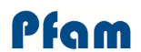
Profile based predictors of protein domains / motifs
Motif database in form of regular expressions. Not necessarily the whole domain.
K-x(12)-[DE] = lysine, any 12, Aspartic acid or Glutamic acid.
Returns 1 or 0, i.e. very rigid and can be very inaccurate for small simple motifs
Motif search tools based on Prosite but with multiple alignment profiling
Collection of HMM’s usually covering the whole domain

Slide 10
Functional assignment: domain architecture
A
B
A
B
C
A
B
C

Slide 11

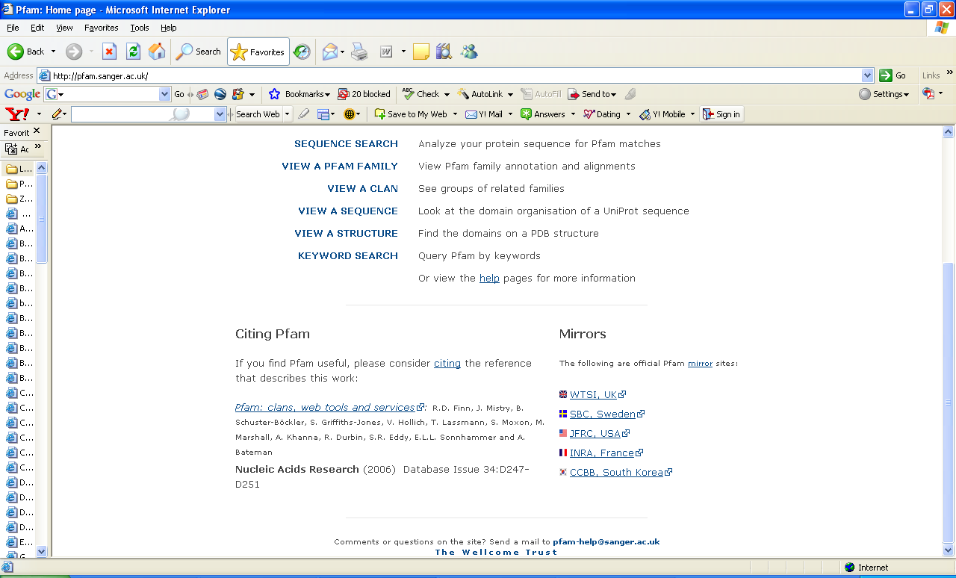

Slide 12
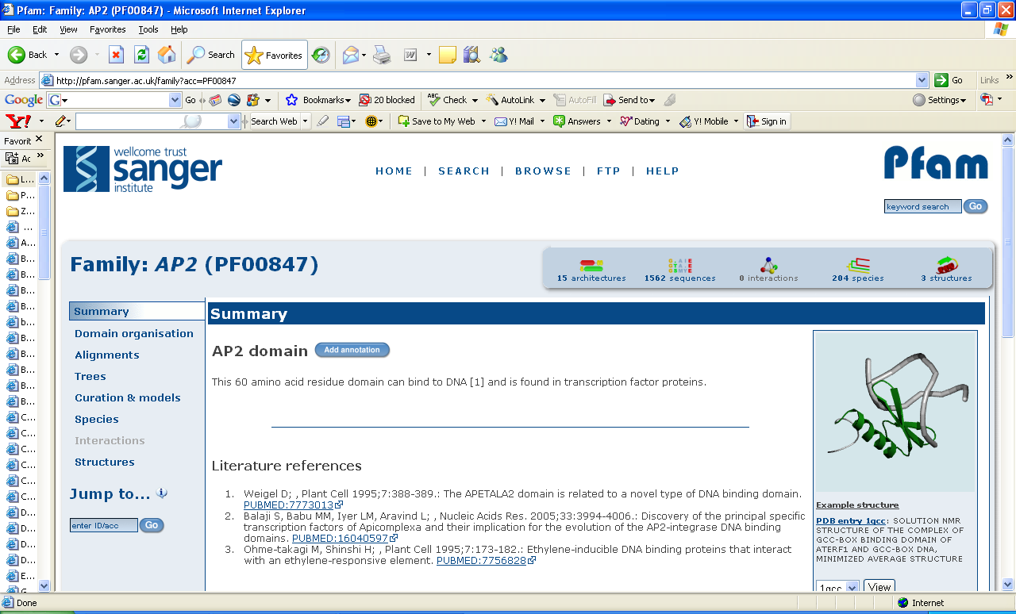
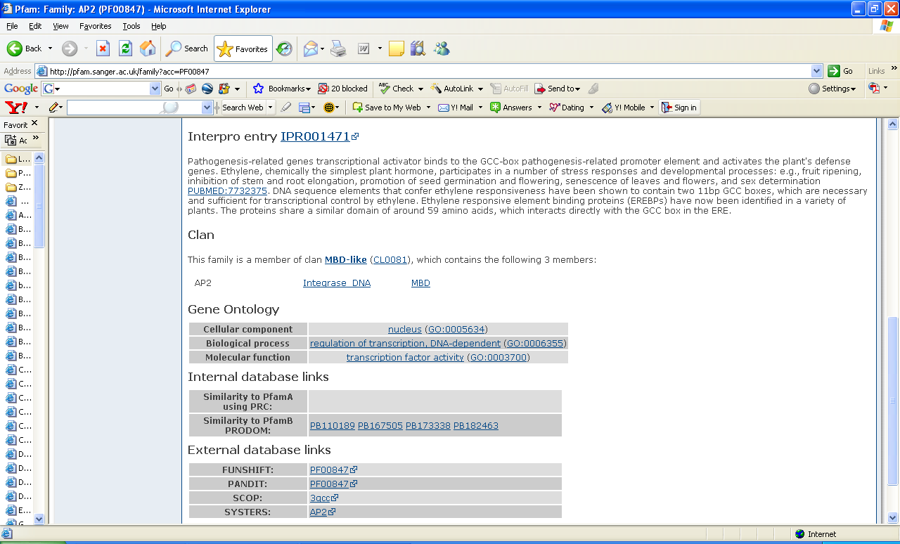

Slide 13
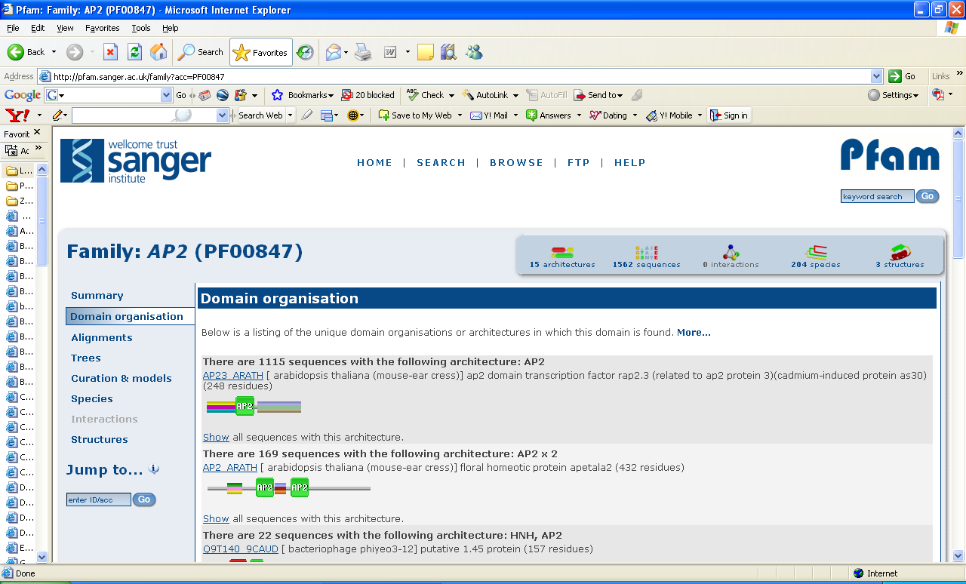
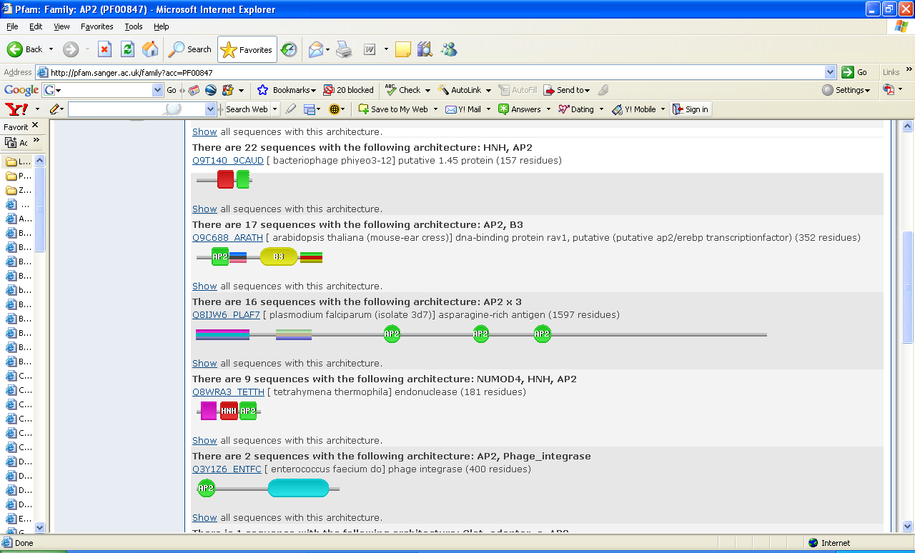

Slide 14
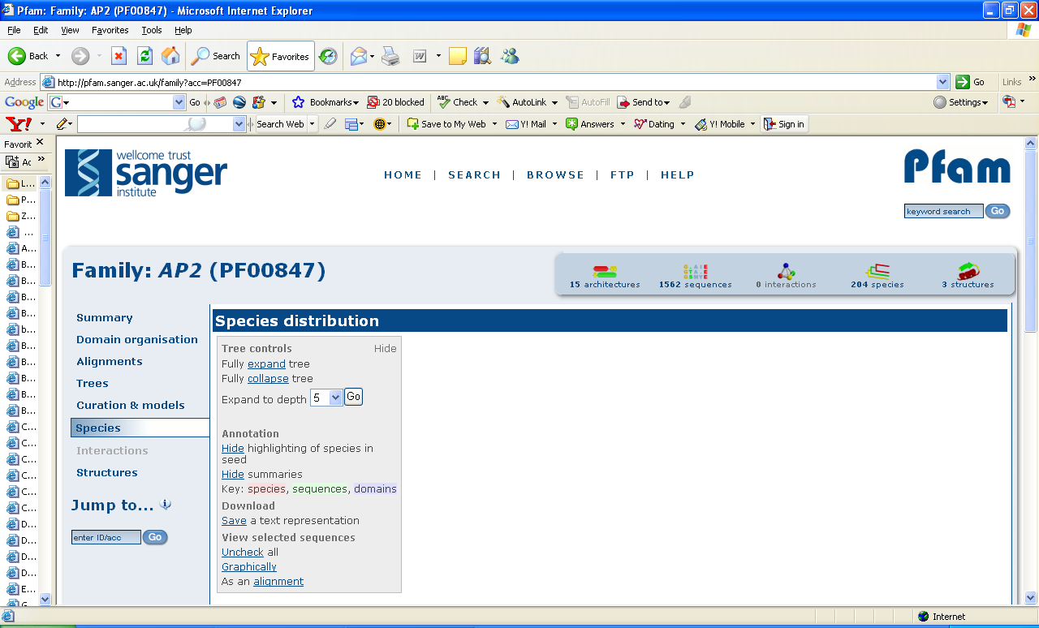
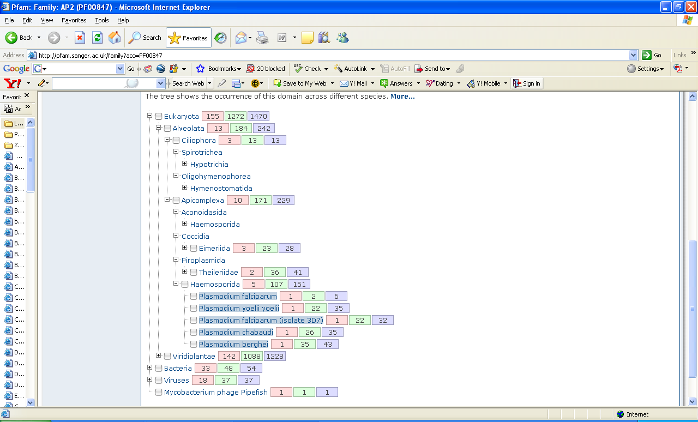

Slide 15
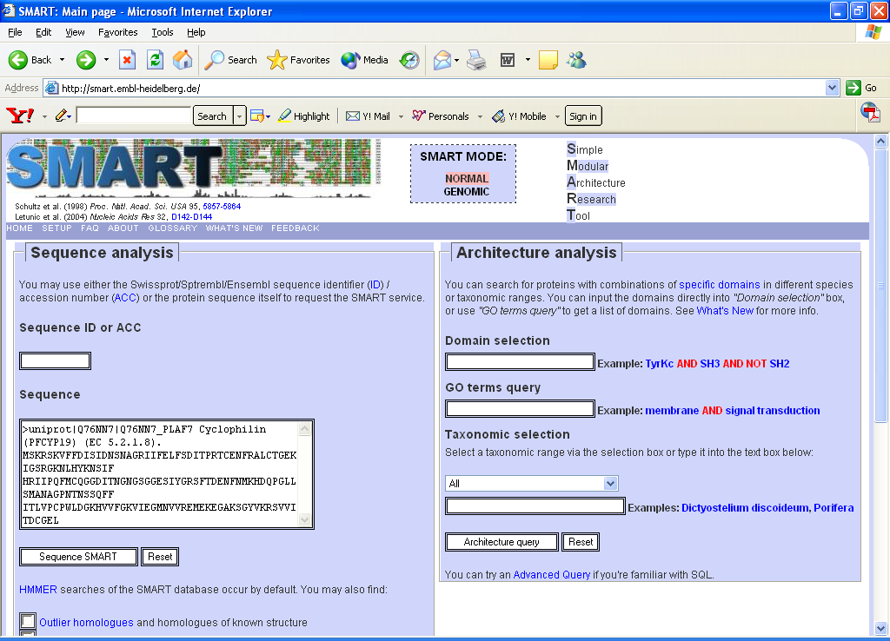
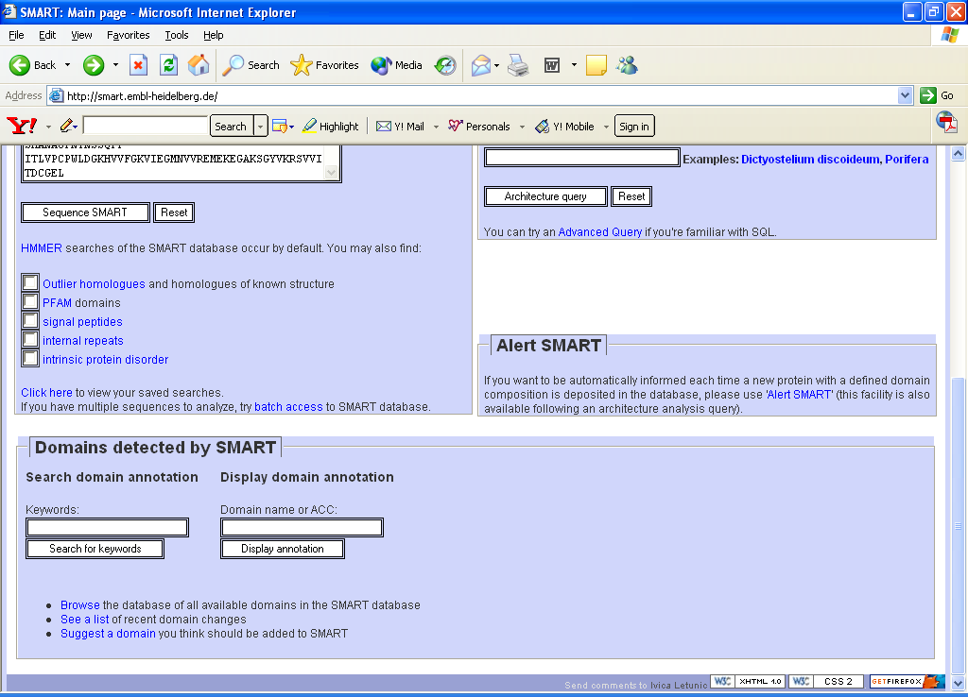

Slide 17
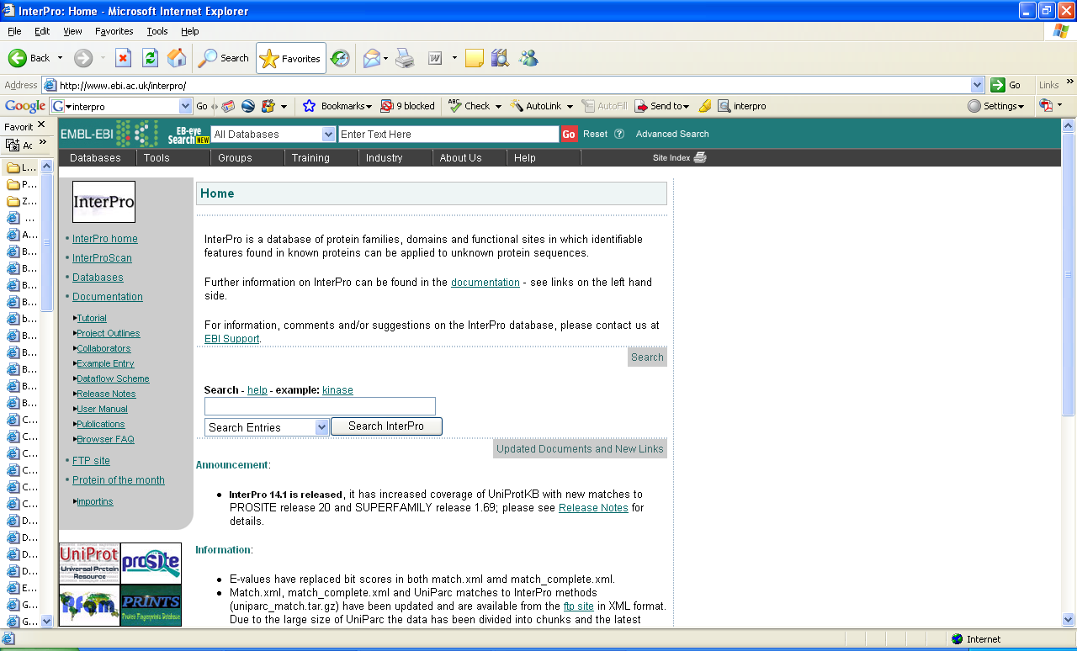
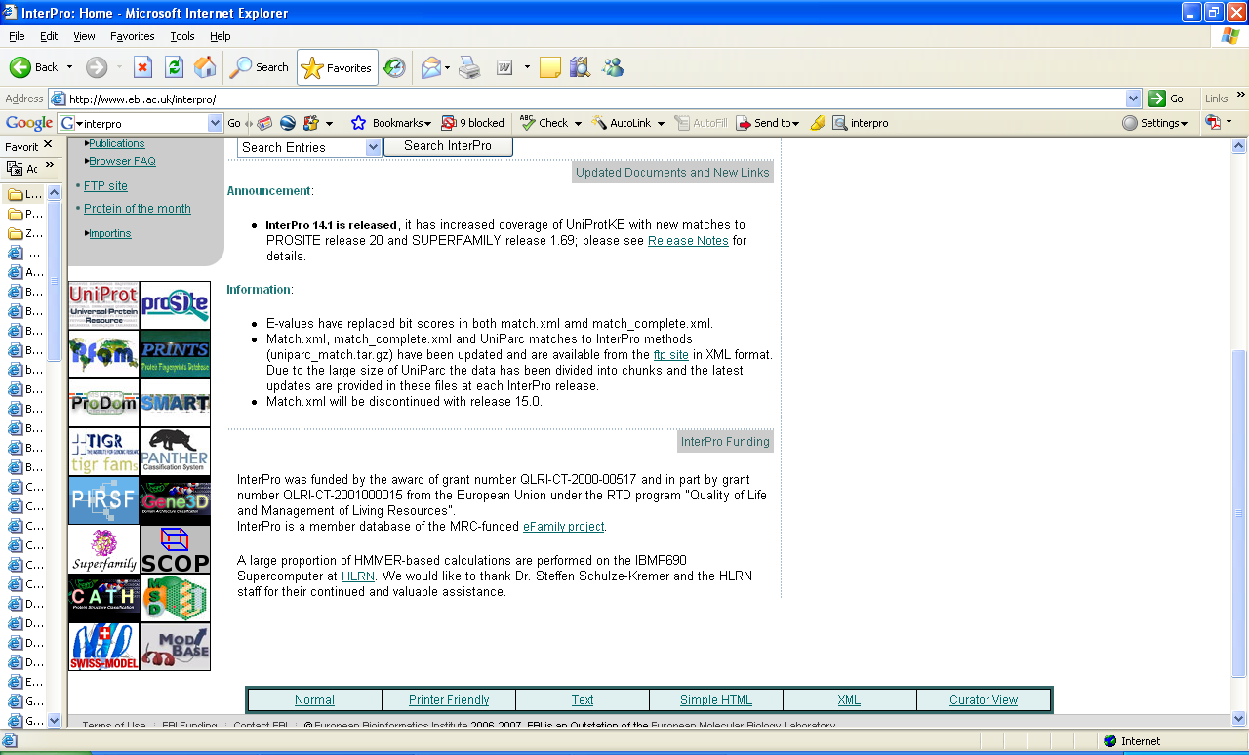
InterPro Server:
• The ‘one-stop shop’ for accessing all major protein databases

Slide 18
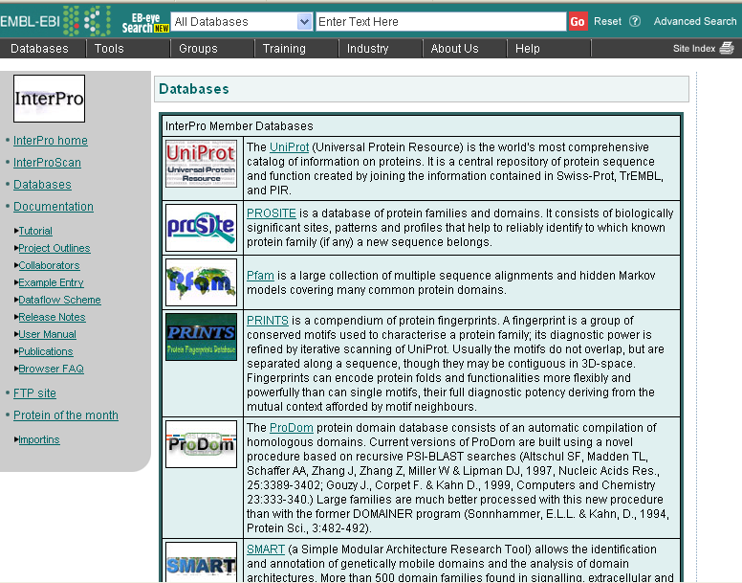
InterPro: member databases

Slide 19
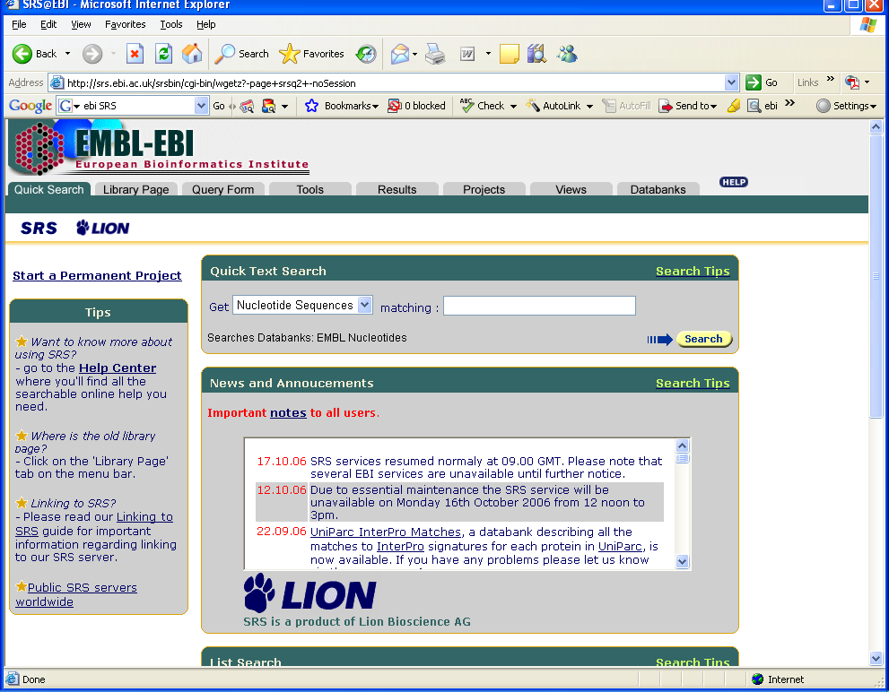
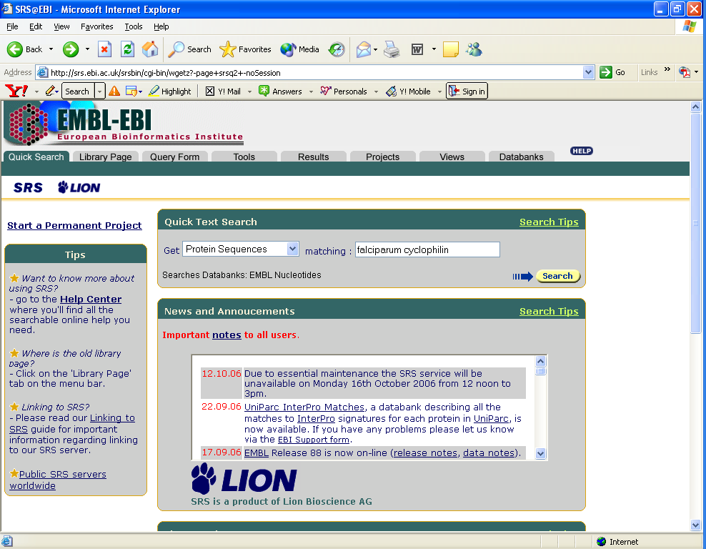
Retrieving a sequence using SRS

Slide 20
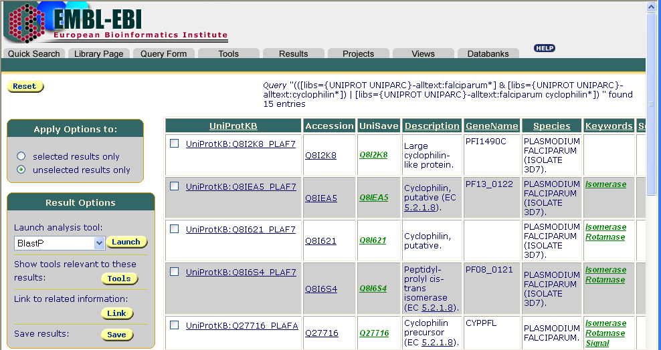
Retrieving a sequence using SRS

Slide 21
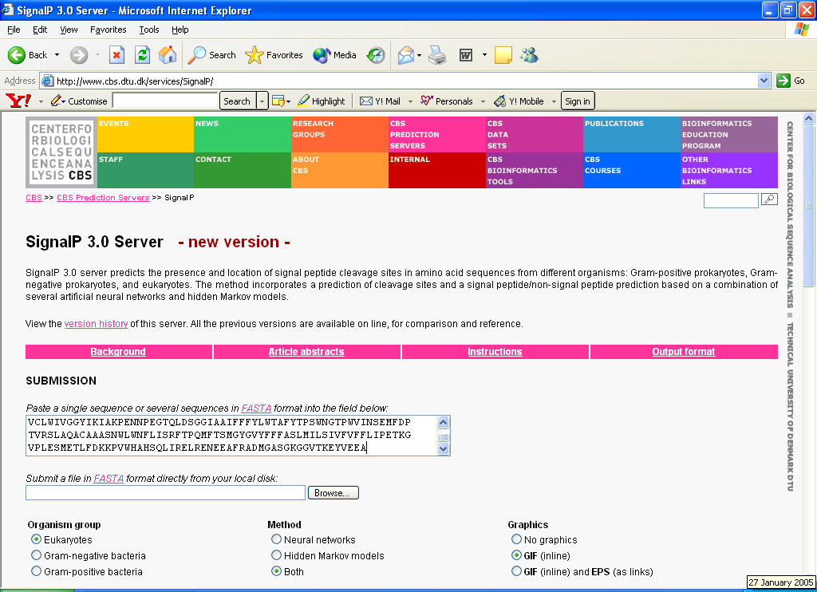
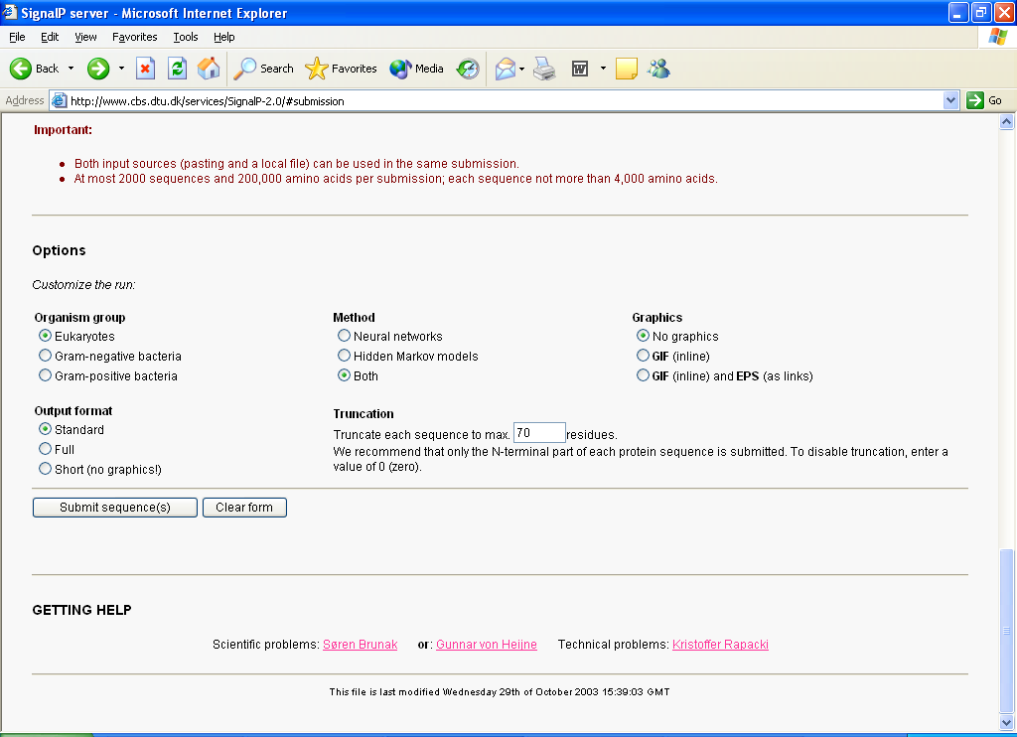
The SignalP 3.0 Server:

Slide 22
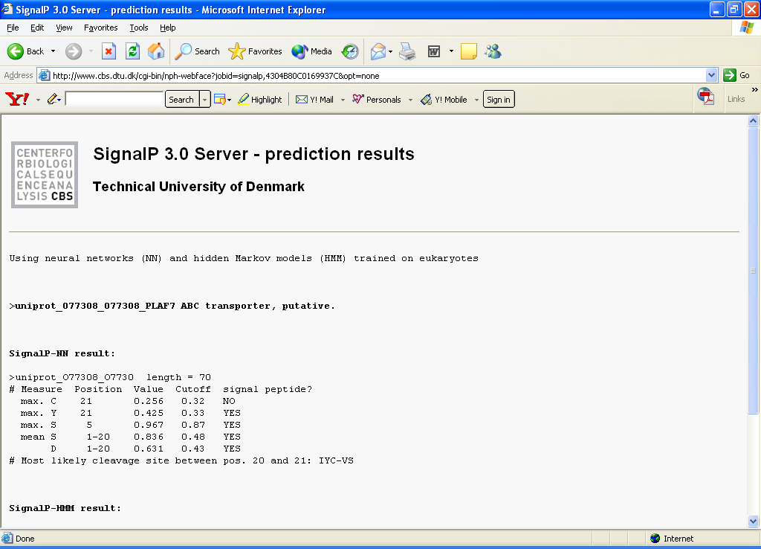
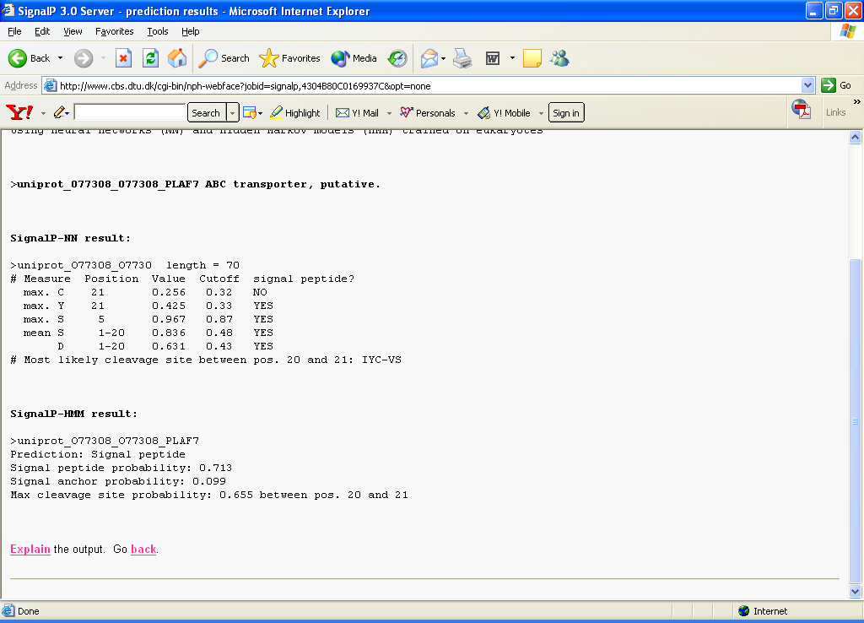
The SignalP 3.0 output:

Slide 23
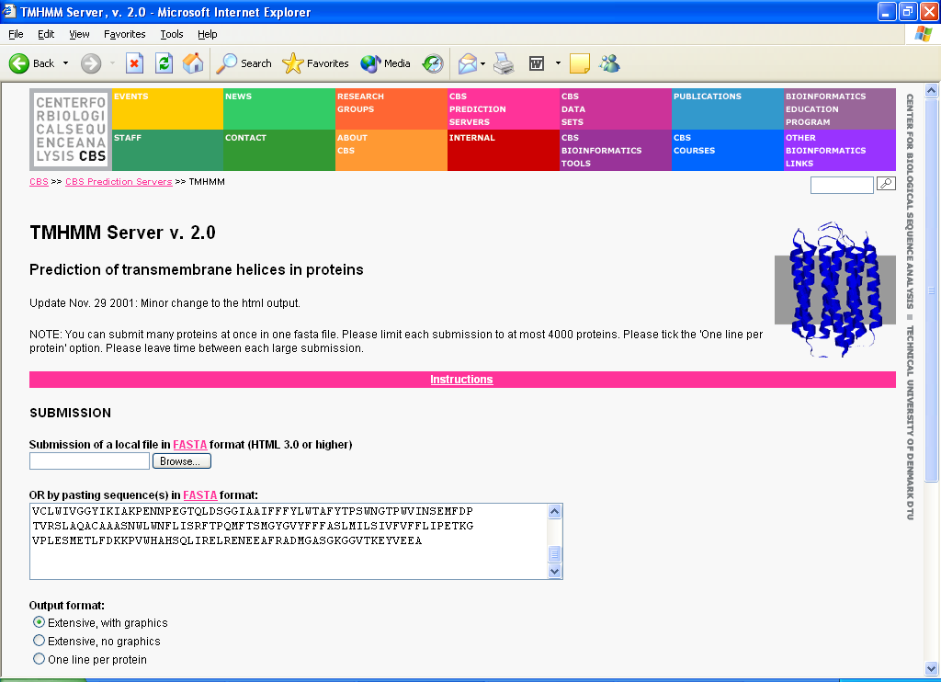
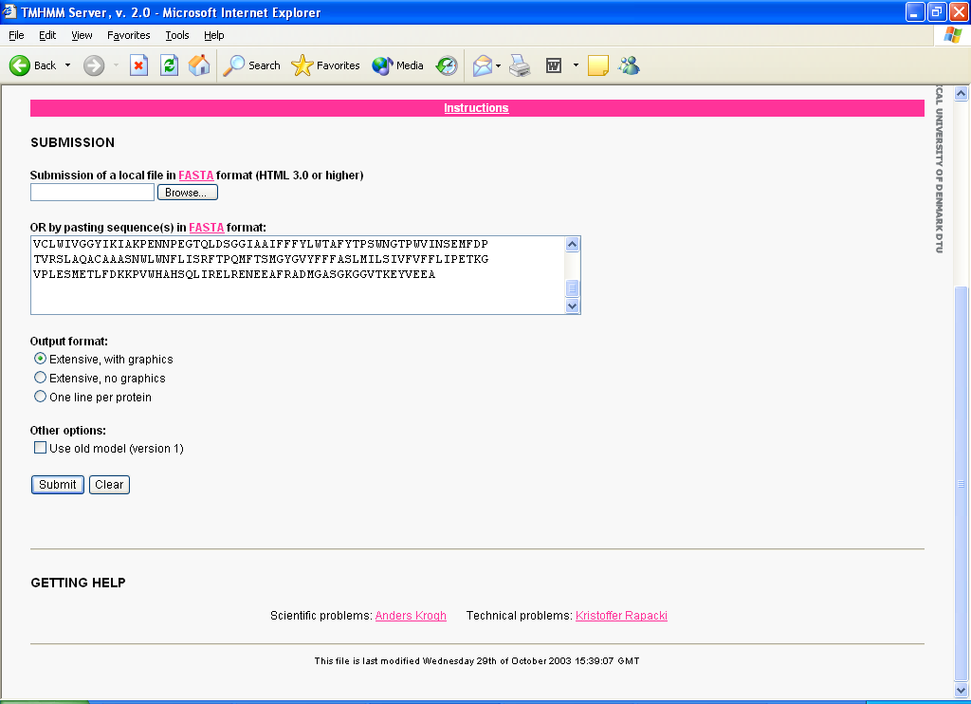
The TMHMMv2.0 Server:

Slide 24
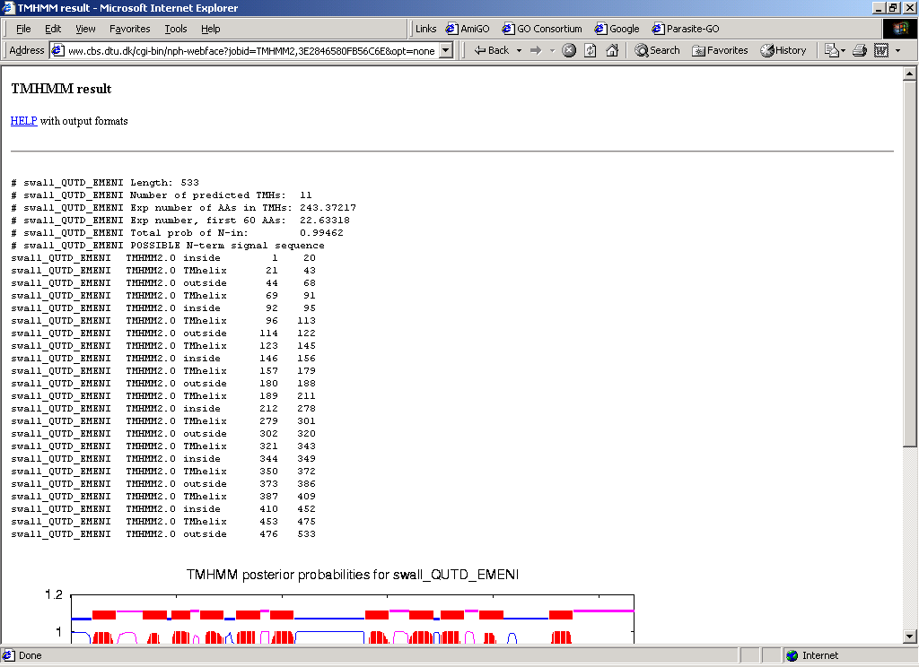
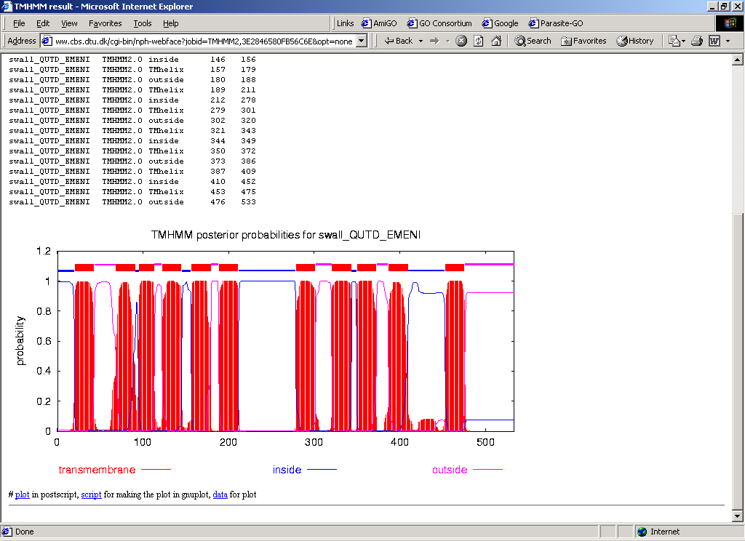
The TMHMM v3.0 output:
Tabular part
Graphical part

Slide 25
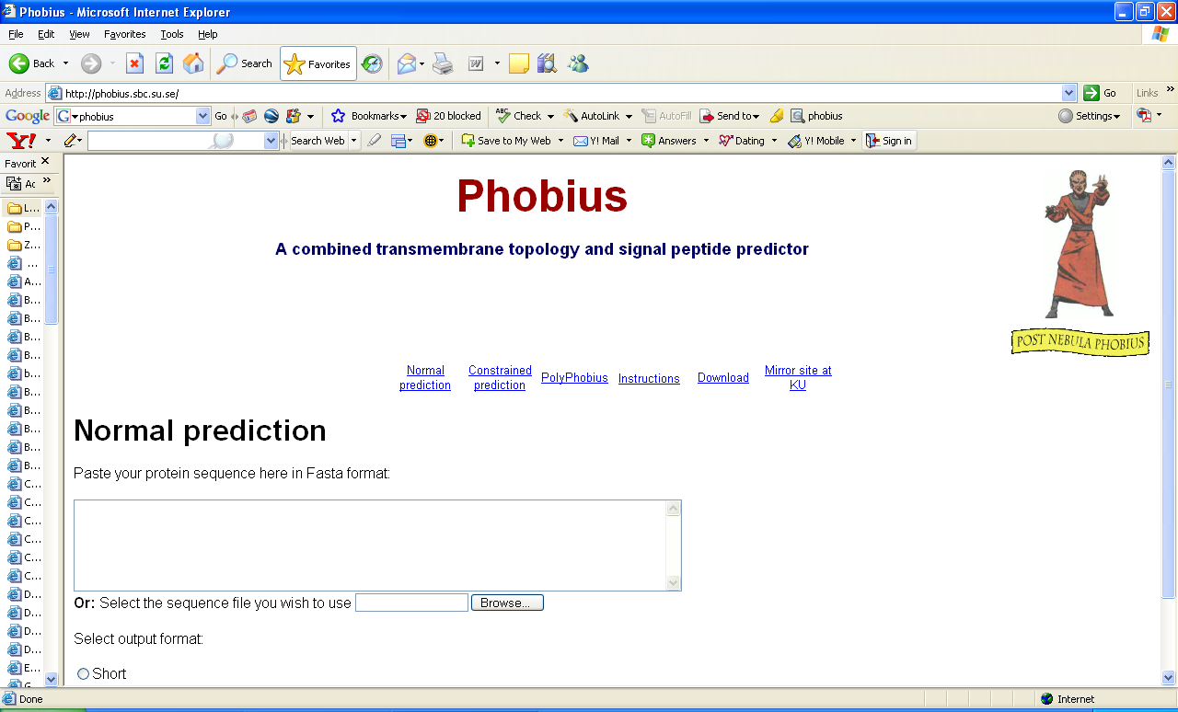
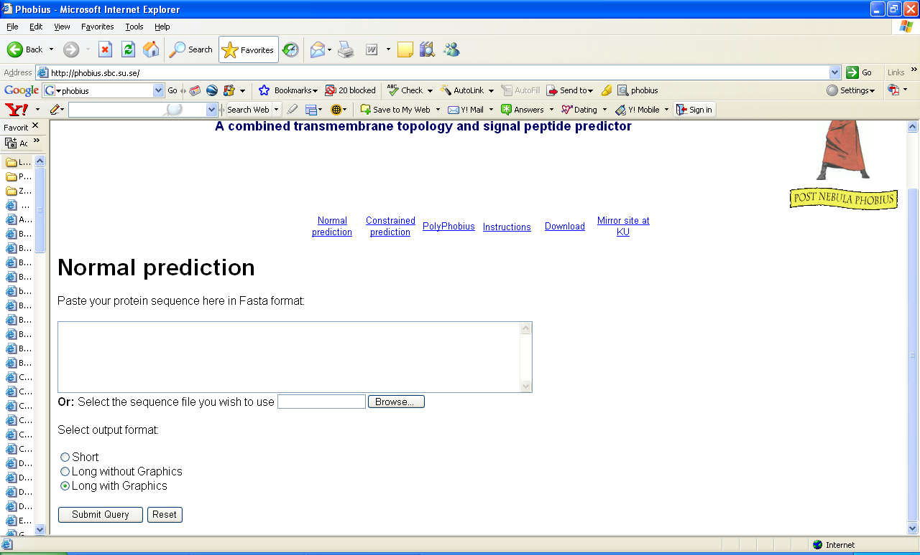

Slide 26
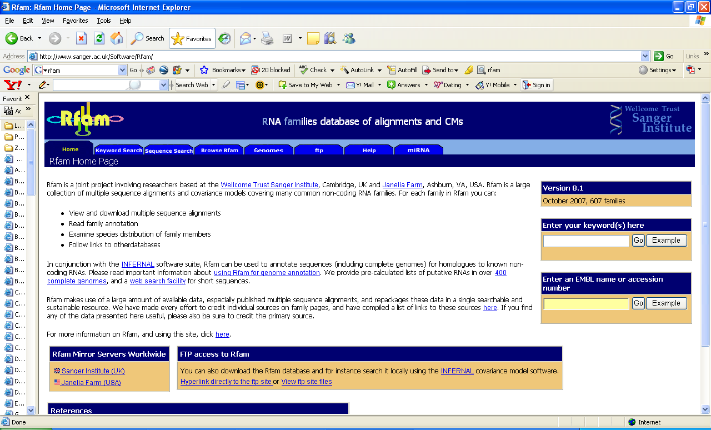
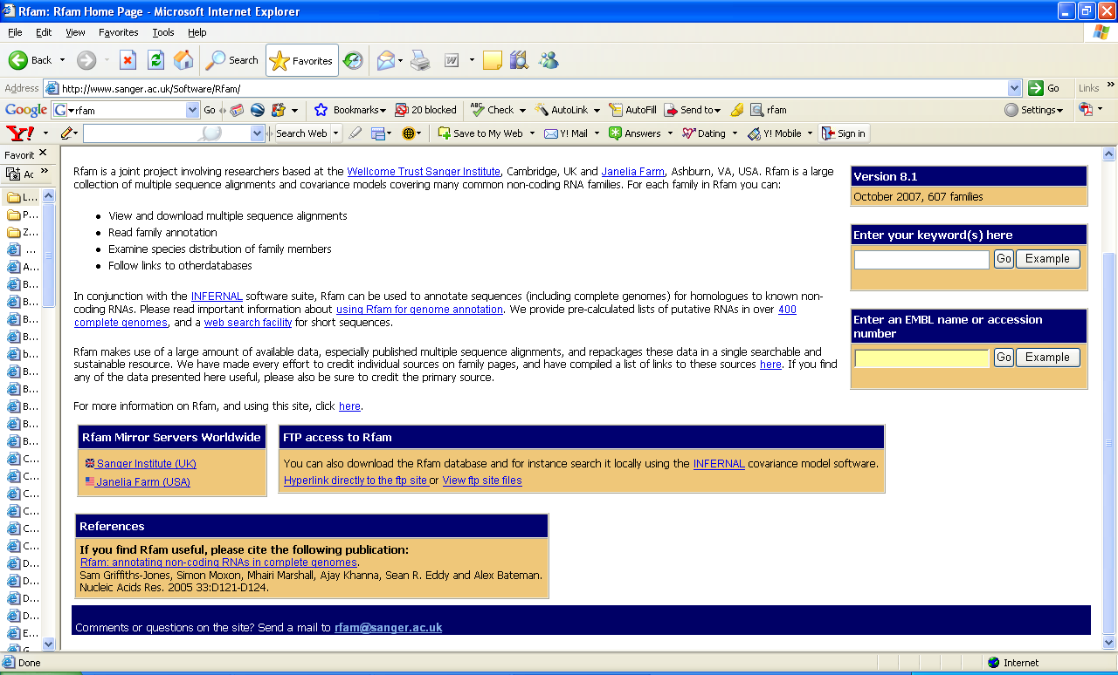

Slide 27
Exercises:
Section A:
• Sequence retrieval of a P. falciparum protein (cyclophilin) using SRS
• BLAST and Fasta searches by cutting & pasting the sequence.
Section B:
Exercise 1 Part I (row 1):
• Search PROSITE server by cutting & pasting the cyclophilin sequence
Exercise 1 Part II (row2):
• Pfam server
Exercise 1 Part III (row3):
• SMART server
Exercise 1 Part IV (row4):
• InterPro server
Exercise 2:
• Sequence retrieval of P. falciparum PFC0125w protein using SRS.
• TMHMMv2.0 server.
• SignalPv3.0 server.
Section C:
• Other web resources

